Slide 1
ai mentorship
Final Project

Slide 2

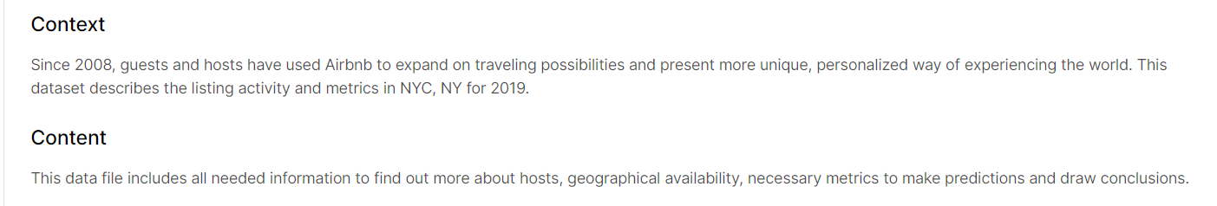
Dataset a

Slide 3

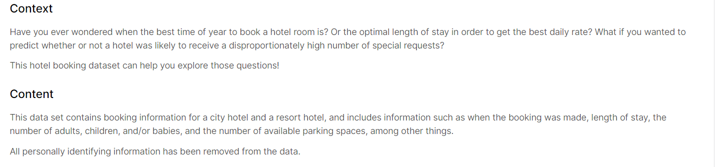
Dataset B

Slide 4
WHAT TO DO with data a
Get the big picture of what the data is about.
Inspect the properties of the data in each column (type, missing value, etc)
Show the amount of data, mean, median, and std.
How much is the min and max price?
Get rid of the missing value:
Drop columns which has missing value that cannot be filled with any logical value (like name, host_id, etc)
Fill the missing value in last_review with the most common date
Fill the missing value in reviews_per_month with the mean
Make category based on the price: Cheap, Medium, and Expensive
Filter all data which has last_review in > 2019
Visualize the price to compare the price of available rooms

Slide 5
WHAT TO DO with data b
Get the big picture of what the data is about.
Inspect the properties of the data in each column (type, missing value, etc)
Show the amount of data, mean, median, and std.
How much is the min and max for column with numerical value?
Get rid of the missing value:
Drop columns which has missing value more than 50% of the total data
Fill the missing value in agent with the mean
Fill the missing value in country, children with the most common name
Make category based on the lead time: Short, Medium, and Long
Filter all data which has reservation_status_date in >2017
Visualize the arrival_date_month to see in what month the most visitors come

Slide 6
Data a
Data B
Ariadi
Nugraha
Lili
Heri
Eriko
Hano
Ferdi
Fakhri
Daffa
Safira
Rizki
Hasbi

